Slide 1
4- Applications of GANs for Image Generation
Risman Adnan Mattotorang
Software R&D Director
Samsung R&D Institute Indonesia

Slide 2
Welcome to Data Science Center UI
What You Will Learn Today
GANs Applications for Vision
GANs Applications for NLP
GANs Application for Speech
Reproduction of Some Models
What You Will Practice Today
Realistic Image Generation
Image to Image Translation
Password Cracking
Text to Speech

Slide 3
Outline
Application of GANs
Image Generation
Conditional GANs
Unsupervised Conditional GANs
GANS and Reinforcement Learning

Slide 4
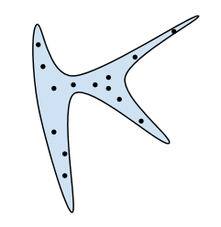

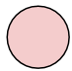
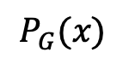
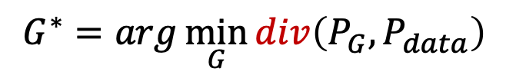
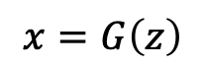
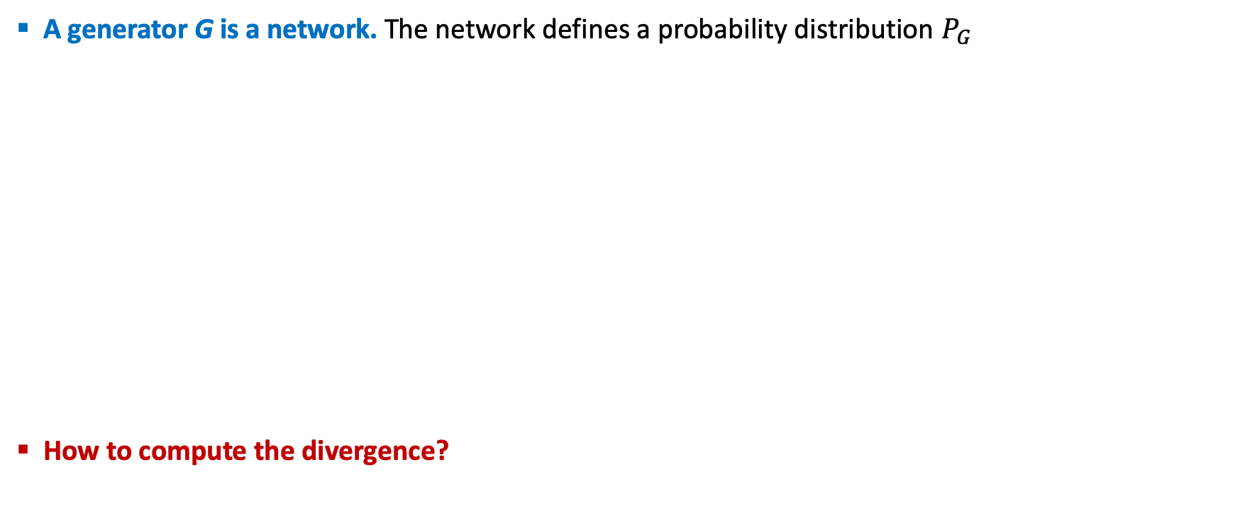
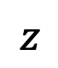
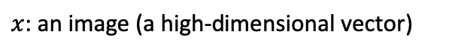
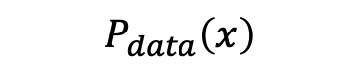
How GANs Work
A generator G is a network. The network defines a probability distribution $P_{G}$
How to compute the divergence?
Normal Distribution
$$P_{G}\text{(}\text{x}\text{)}$$
$$P_{data}\left(x\right)$$
Generator
Network
G
$$z$$
Distance or
Divergence
$$x=G\left(z\right)$$
$x$: an image (a high-dimensional vector)
$$G^{∗}=arg\min_{G}{div\left(P_{G},P_{data}\right)}$$

Slide 5
Why Generative Models Important?
Advantages of Generative Models:
Represent and manipulate high-dimensional probability distribution
Can be incorporated into (inverse) reinforcement learning in several ways
Can be trained with missing data on semi-supervised learning
Can provide predictions on inputs that are missing data
Enable machine learning to work with multi-modal outputs
Many tasks intrinsically require realistic generation of samples from some distributions:
Creating Art and Realistic Images
Single Image Super-Resolution
Image-To-Image Translation
What I cannot create, I do not understand!
-- Richard Feynman

Slide 6
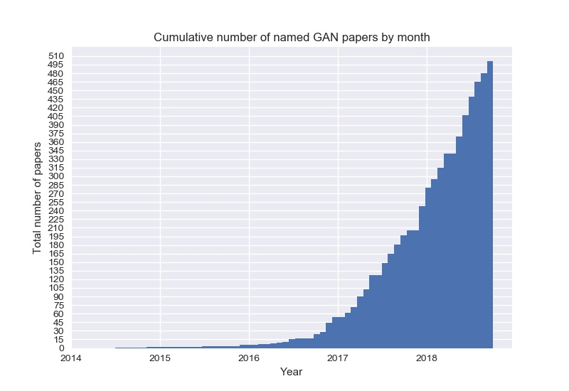
Why This Course is Important: GAN Zoo
GAN
ACGAN
BGAN
CGAN
DCGAN
EBGAN
fGAN
GoGAN
……
$$α β γ$$

Slide 7
Applications of Generative Models
Computer Vision | Speech Recognition | Natural Language
Realistic Image Creation | Generative Speech Enhancement | Realistic Text Generation
Image-to-Image Translation | Speech Driven Animation | Text Translation
Synthetic Image Creation | Lips Talking and Reading | Text Corpora Generation
Image and Shape In-Painting | Synthetic Audio/Voice | Generative Machine Translation
Object/Image Reconstruction | Voice Conversion | Conditional Sequence Generation
Image Super-Resolution | Voice Separation | Neural Dialog Generation
Face Emotion and Aging | Voice Impersonation | Generative Conversation Responses
Video Frame Prediction | Speech and Speaker Emotion | Text Style Transfer
Video Deblurring | Postfilter for Synthesized speech | Abstractive Summarization
Many More …. | Many More …. | Many More ….
Source: The GAN Zoo and Really Awesome GAN

Slide 8
Outline
Application of GANs
Image Generation
Conditional GANs
Unsupervised Conditional GANs
GANS and Reinforcement Learning

Slide 9
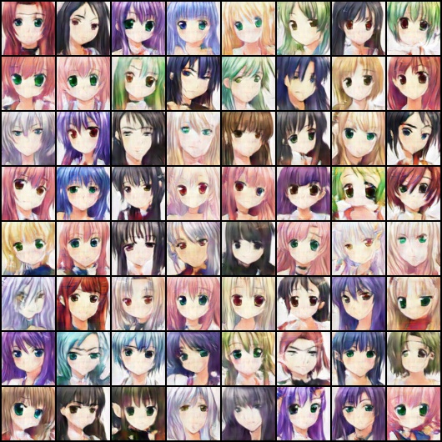
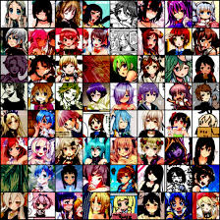
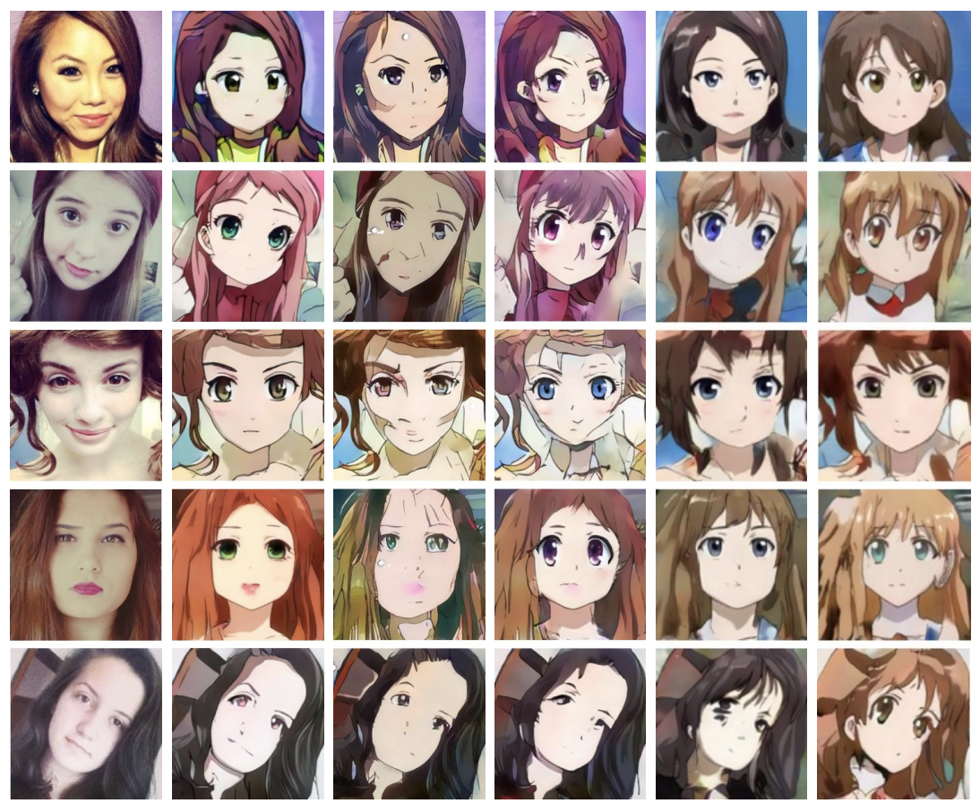
GANs Generated Realistic Images
Input: Face anime images
Output: Realistic face anime images

Slide 10
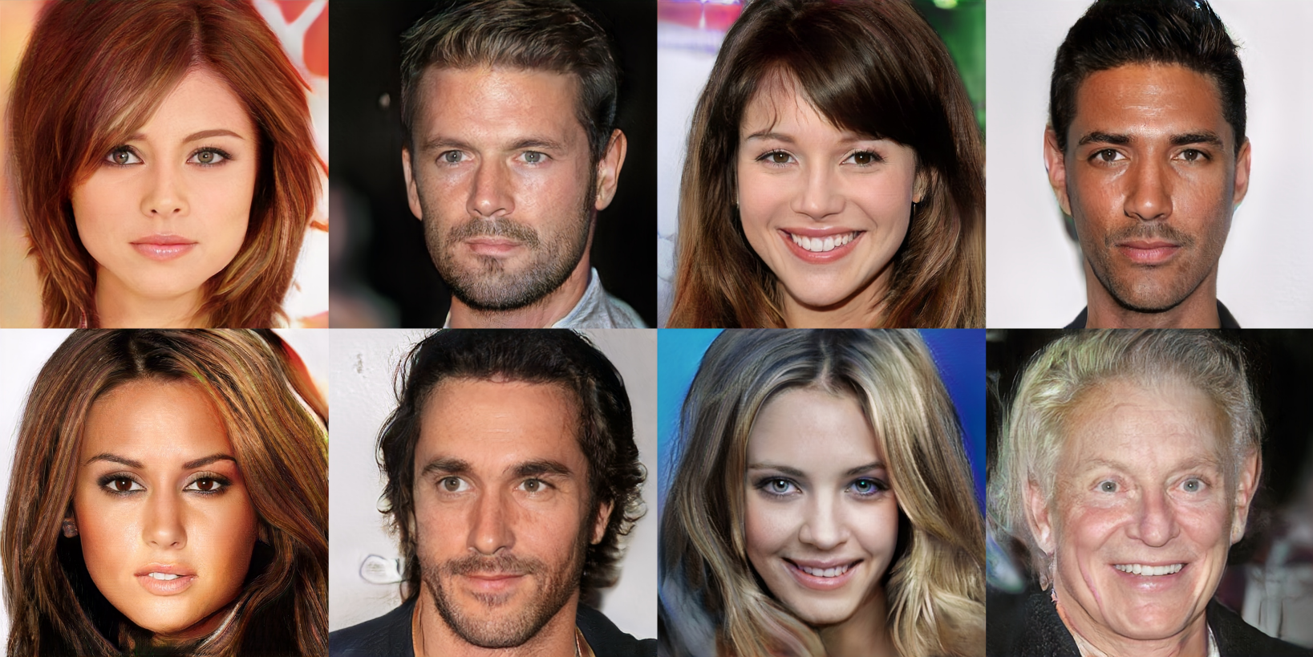
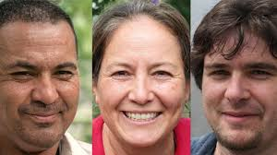
GANs Generated Realistic Images
Input: CelebA Dataset
Output: Realistic celebrity looking faces
All of those faces are fake!

Slide 11
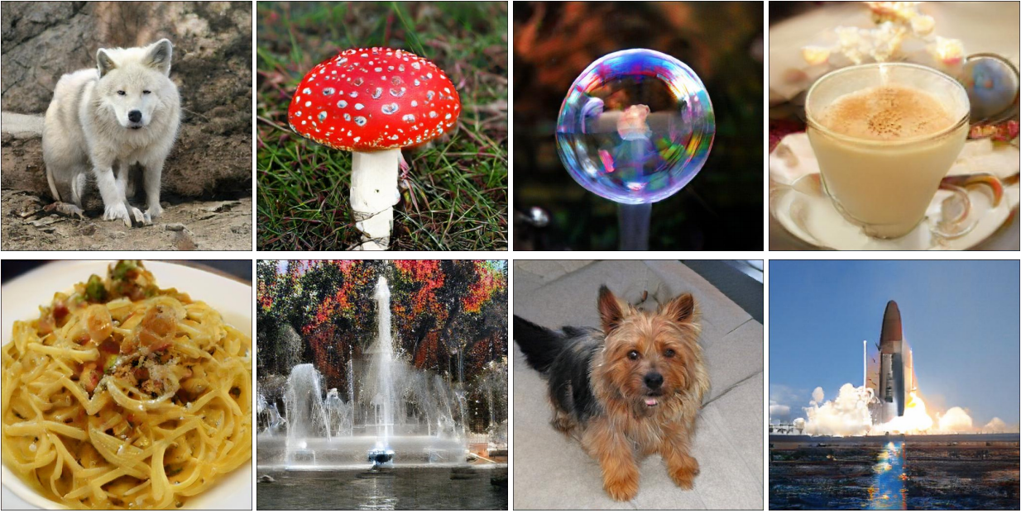
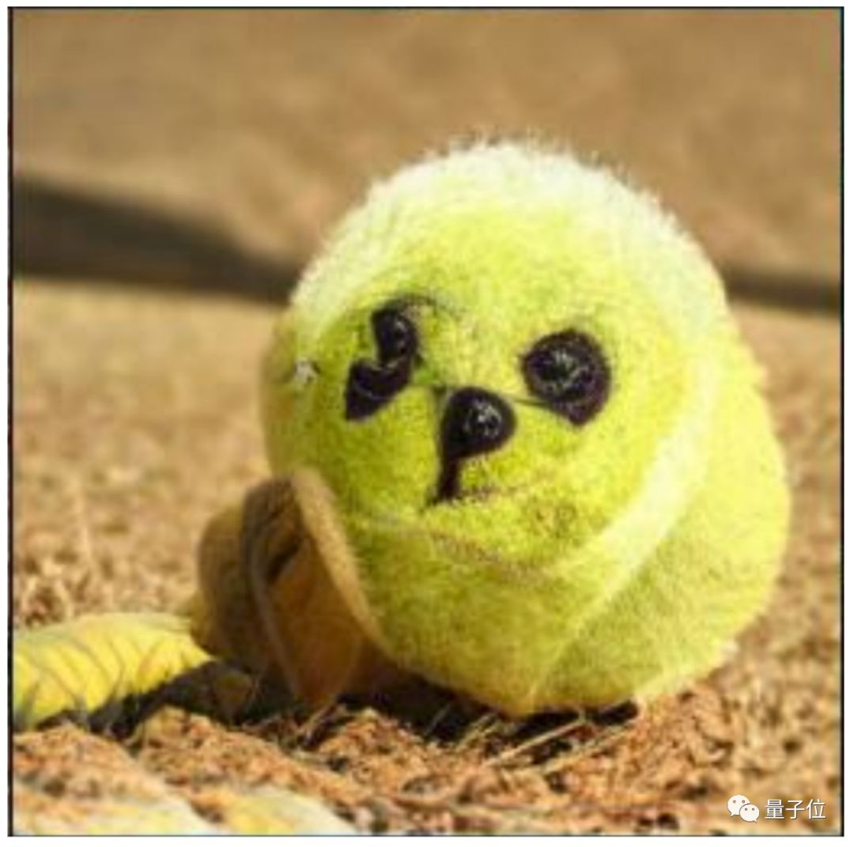
GANs Generated Realistic Images
Input: ImageNet Dataset
Output: Realistic and natural objects/things

Slide 12
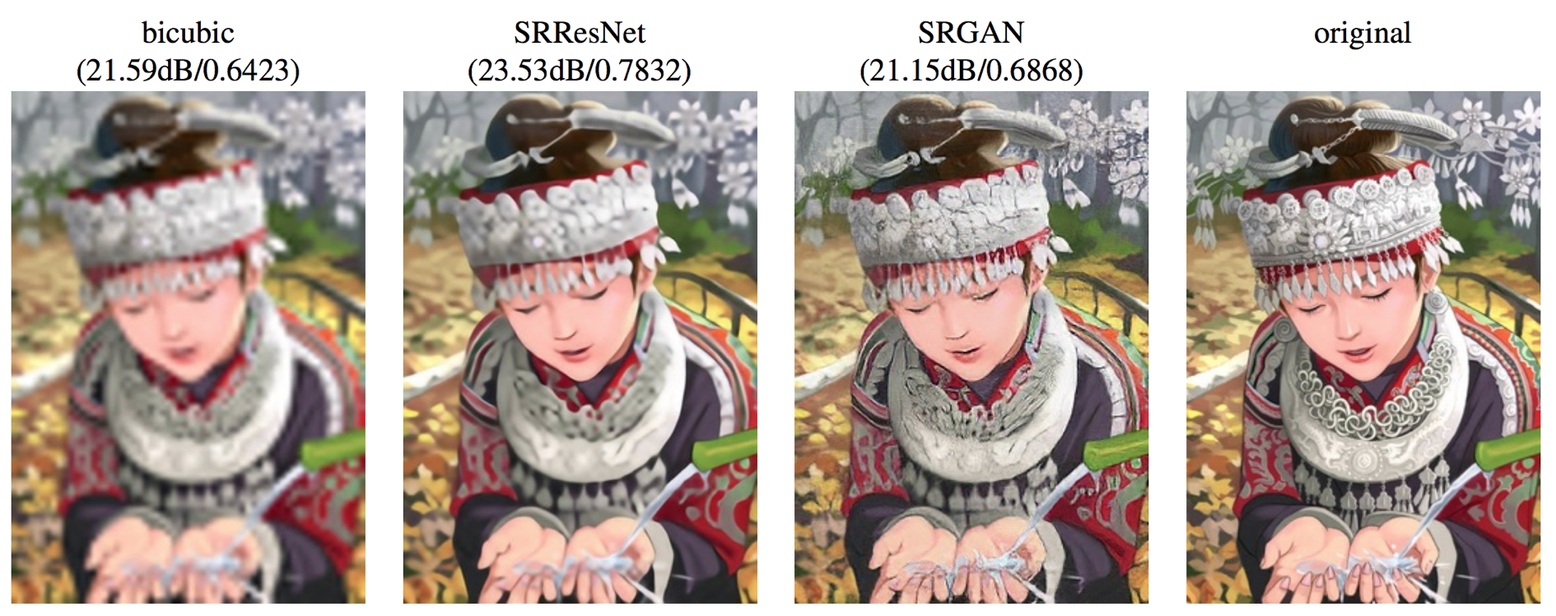
GANs for Image Super Resolution
Input: Low Resolutions ImageNet Dataset
Output: Super Resolution Realistic and natural objects/things

Slide 13
Outline
Application of GANs
Image Generation
Conditional GANs
Unsupervised Conditional GANs
GANS and Reinforcement Learning

Slide 14
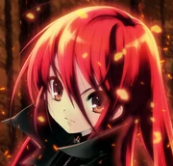
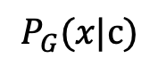
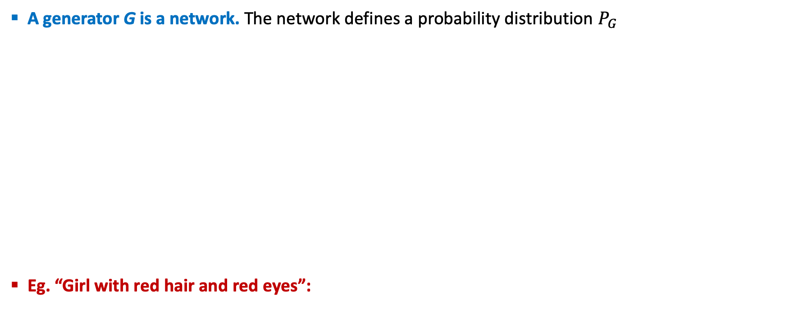
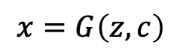
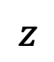
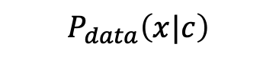
How Conditional GANs Work
A generator G is a network. The network defines a probability distribution $P_{G}$
Eg. “Girl with red hair and red eyes”:
Normal Distribution
$$P_{data}\left(x|c\right)$$
$$P_{G}\text{(}\text{x}\text{|}\text{c}\text{)}$$
Generator
Network
G
$$z$$
condition c
Distance or
Divergence
$$x=G\left(z,c\right)$$
$x$: an image (a high-dimensional vector) per condition c
[Mehdi Mirza, et al., arXiv, 2014]

Slide 15
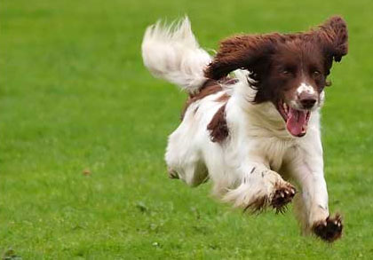
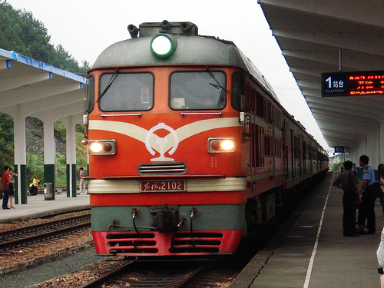
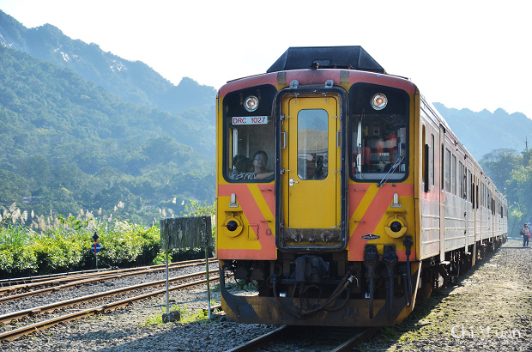
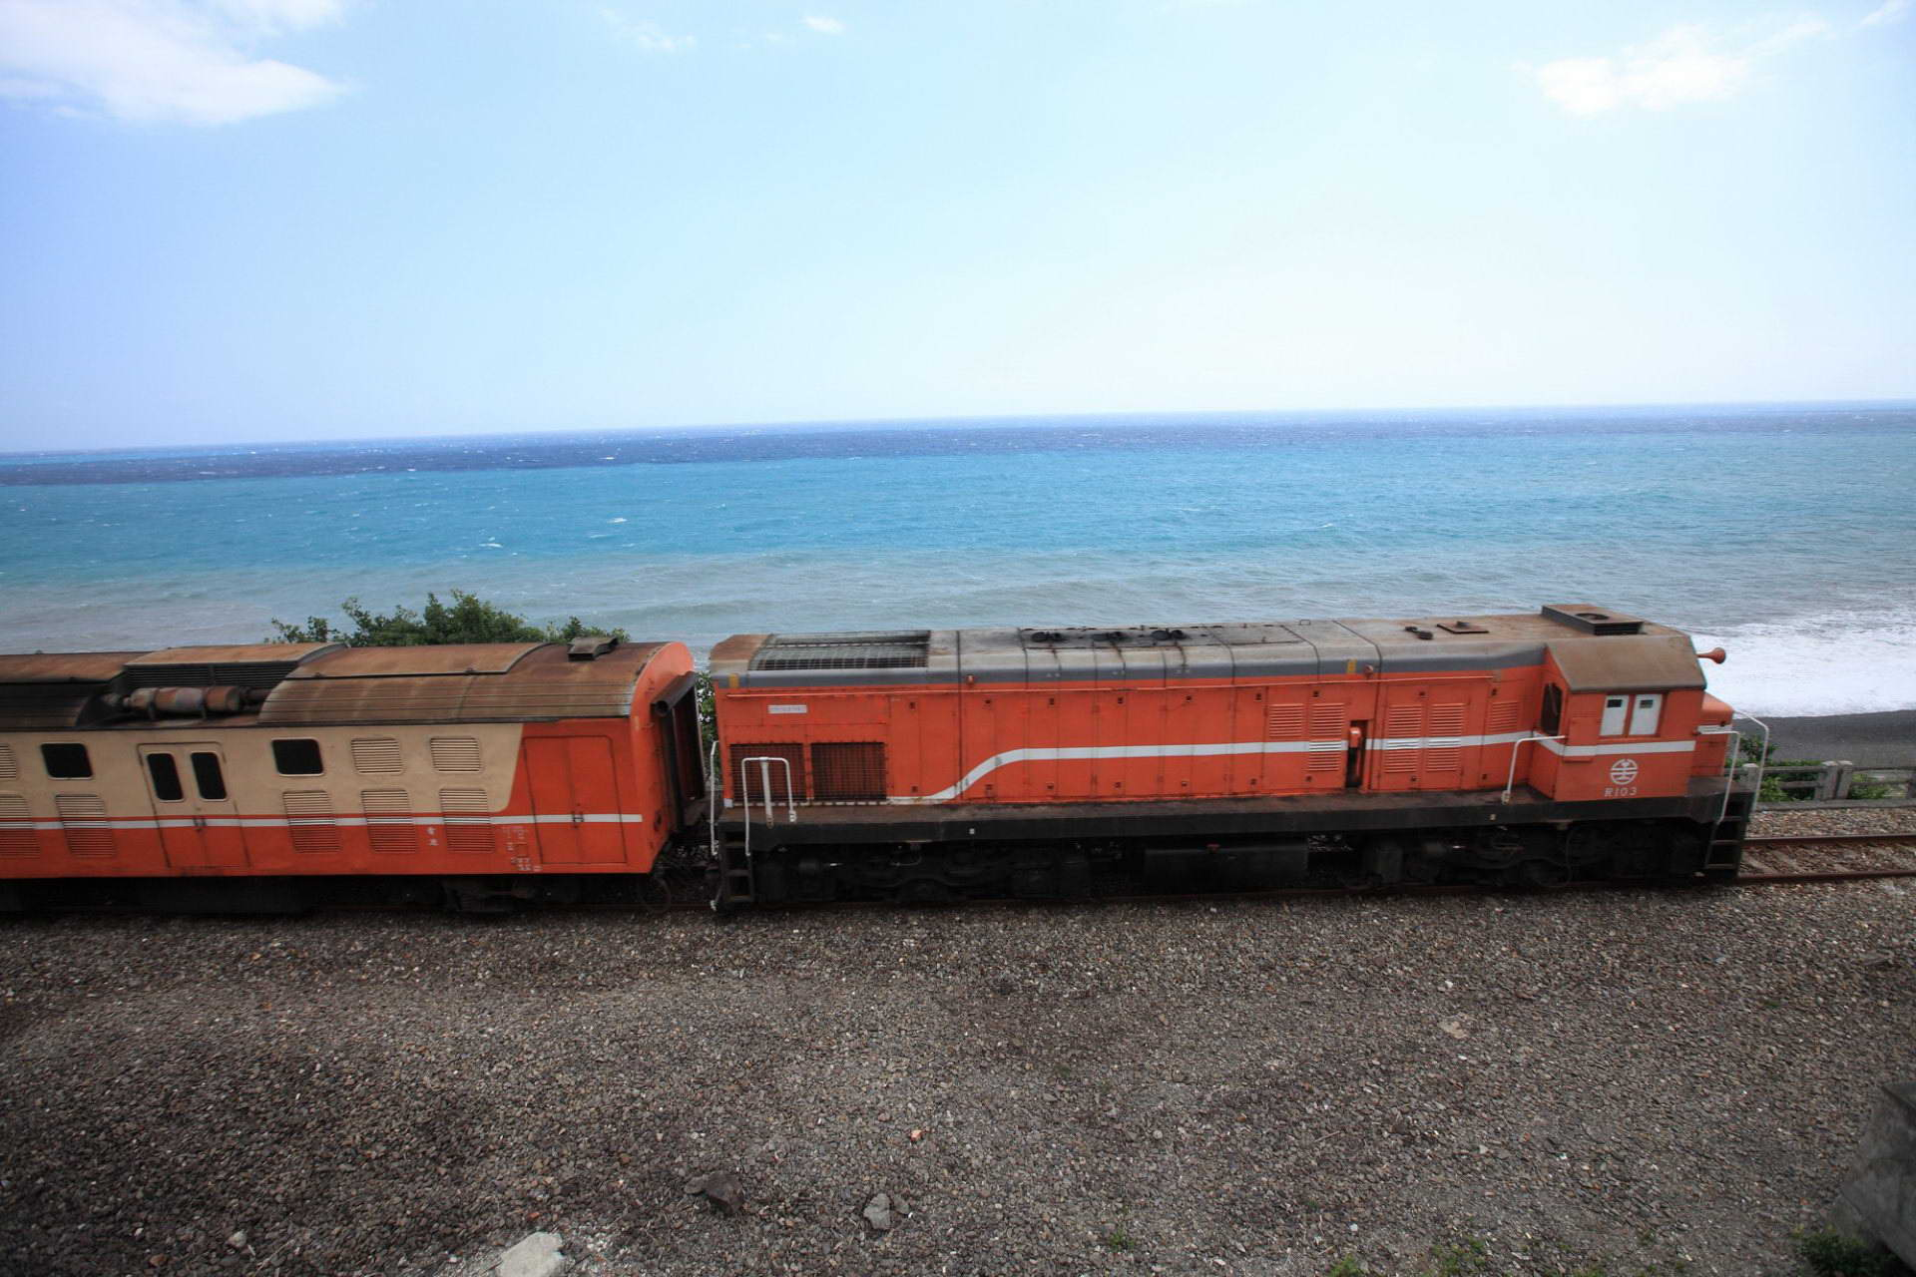
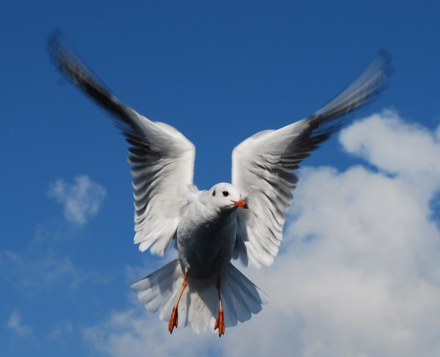
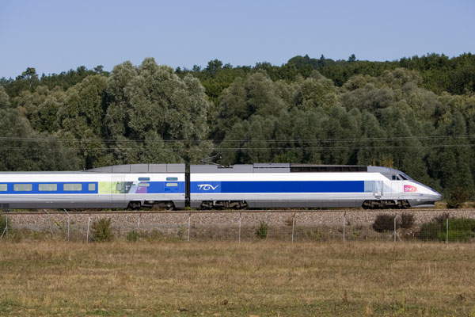
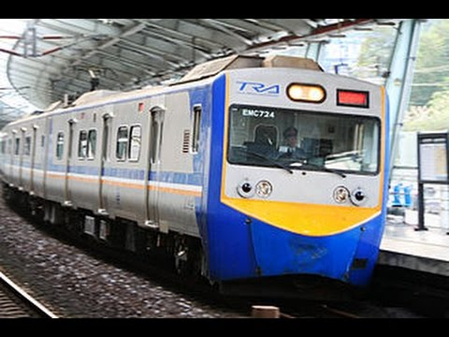
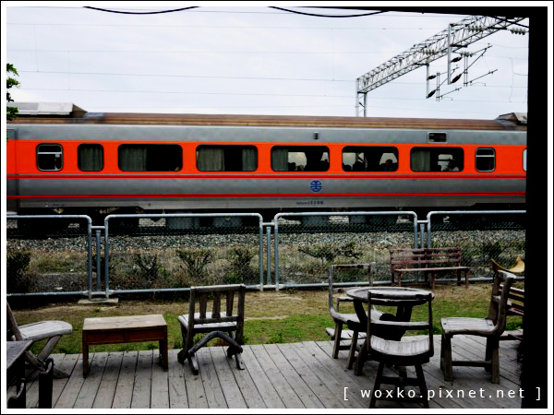
Text to Image
Traditional Supervised Approach
Image
as close
as possible
NN
c¹: a dog is running
a dog is running
Text: “train”
a bird is flying
Target of NN Output
A blurry image!

Slide 16


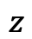
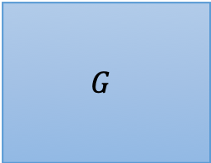
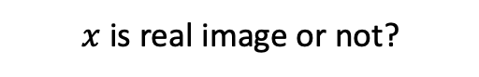
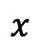
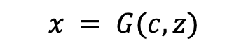
Conditional GANs
Conditional GANs Approach
[Scott Reed, et al, ICML, 2016]
c: train
$$G$$
Image
$$x = G(c,z)$$
Normal distribution
$$z$$
$x$ is real image or not?
D
(original)
Real images:
1
$$x$$
scalar
Generated images:
0
Generator will learn to generate realistic images ….
But completely ignore the input conditions.

Slide 17
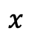
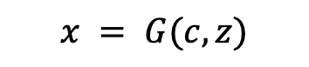
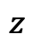
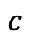
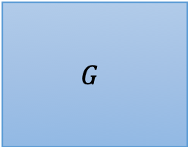
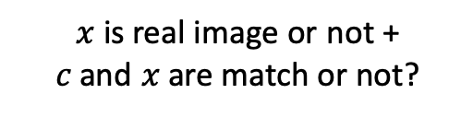
Conditional GANs
Conditional GANs Approach
[Scott Reed, et al, ICML, 2016]
c: train
$$G$$
Image
$$x = G(c,z)$$
Normal distribution
$$z$$
$x$ is real image or not + $c$ and $x$ are match or not?
D
(original)
(train, , )
$$x$$
True text-image pairs:
1
scalar
$$c$$
(cat , )
0
(train, )
0

Slide 18
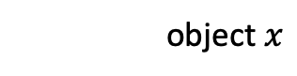
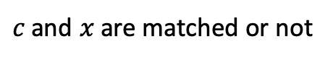
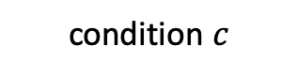
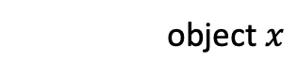
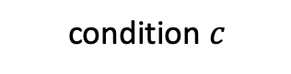
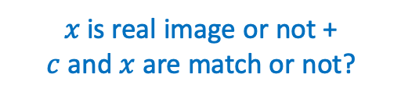
Conditional GANs - Discriminator
$x$ is real image or not + $c$ and $x$ are match or not?
object $x$
Network
Network
score
condition $c$
Network
(almost every paper)
[Augustus Odena et al., ICML, 2017]
[Takeru Miyato, et al., ICLR, 2018]
[Han Zhang, et al., arXiv, 2017]
object $x$
Network
x is realistic or not
condition $c$
Network
$c$ and $x$ are matched or not

Slide 19

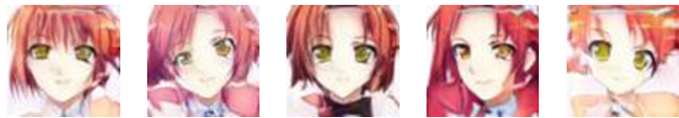

Conditional GANs
The images are generated by Yen-Hao Chen, Po-Chun Chien, Jun-Chen Xie, Tsung-Han Wu.
paired data
blue eyes
red hair
short hair
Collecting anime faces and the description of its characteristics
red hair, green eyes
blue hair, red eyes

Slide 20





Conditional GANs – Image to Image
Image to image translation or pix2pix
[Phillip Isola, et al., CVPR, 2017]
$$c$$
G
$$x = G(c,z)$$
$$z$$

Slide 21


Conditional GANs – Image to Image
Traditional Supervised Approach
It is blurry.
Testing:
NN
Image
as close as possible
Input
L1
e.g. L1

Slide 22



Conditional GANs – Image to Image
Conditional GANs Approach
[Phillip Isola, et al., CVPR, 2017]
L1
G
Image
D
scalar
$$z$$
Testing:
input
L1
GAN
GAN + L1

Slide 23


Conditional GANs – Video Generator
Conditional GANs Approach
[Michael Mathieu, et al., arXiv, 2015]
Generator
Discriminator thinks it is real
Discriminator
Last frame is real or generated

Slide 24



Conditional GANs – Sound to Image
Conditional GANs Approach for Sound to Image
"a dog barking sound"
G
Image
c: sound
Training Data Collection
video

Slide 25













Conditional GANs – Audio to Image
Conditional GANs Approach for Audio to Image
Louder

Slide 26



Conditional GANs – Image to Label
Multi Labels Image Classifier
Input condition
Generated output

Slide 27


Conditional GANs – Image to Label
The classifiers can have different architectures.
The classifiers are trained as conditional GAN.
The classifiers can have different architectures.
The classifiers are trained as conditional GAN.
Conditional GAN outperforms other models designed for multi-label.
[Tsai, et al., submitted to ICASSP 2019]

Slide 28

Domain Adversarial Training
Training and testing data are in different domains
Take digit
classification as example
Generator
feature
Training data:
The same distribution
Testing data:
Generator
feature

Slide 29




Domain Adversarial Training
feature extractor (Generator)
Always output
zero vectors
Domain Classifier Fails
image
Which domain?
Discriminator
(Domain classifier)
blue points
red points

Slide 30

Domain Adversarial Training
feature extractor (Generator)
Label predictor
Which digits?
image
Which domain?
Not only cheat the domain classifier, but satisfying label predictor at the same time
Discriminator
(Domain classifier)
Successfully applied on image classification [Ganin et al, ICML, 2015][Ajakan et al. JMLR, 2016 ]
Notes:
c.f. reconstructor in CycleGAN

Slide 31
Outline
Application of GANs
Image Generation
Conditional GANs
Unsupervised Conditional GANs
GANS and Reinforcement Learning

Slide 32






Unsupervised Conditional GAN
G
Condition
Generated Object
Object in Domain X
Object in Domain Y
Transform an object from one domain to another without paired data
Domain X
Domain Y
Not Paired
photos
Vincent van Gogh’s paintings
Use image style transfer as example here

Slide 33






Unsupervised Conditional Generation
Approach 1: Direct Transformation
Approach 2: Projection to Common Space
$$G_{X→Y}$$
?
For texture or color change
Domain X
Domain Y
$${EN}_{X}$$
$${DE}_{Y}$$
Domain X
Encoder of domain X
Face
Attribute
Decoder of domain Y
Domain Y
Larger change, only keep the semantics
Notes:
This is not real example.

Slide 34


Direct Transformation
Domain X
Domain Y
Become similar to domain Y
Domain X
$$G_{X→Y}$$
?
$$D_{Y}$$
scalar
Input image belongs to domain Y or not
Domain Y
Notes:
https://arxiv.org/abs/1703.10593
https://junyanz.github.io/CycleGAN/
Berkeley AI Research (BAIR) laboratory, UC Berkeley

Slide 35
Direct Transformation
Domain X
Domain Y
Become similar to domain Y
Domain X
$$G_{X→Y}$$
Not what we want!
ignore input
$$D_{Y}$$
scalar
Input image belongs to domain Y or not
Domain Y
Notes:
https://arxiv.org/abs/1703.10593
https://junyanz.github.io/CycleGAN/
Berkeley AI Research (BAIR) laboratory, UC Berkeley

Slide 36
Direct Transformation
Domain X
Domain Y
Become similar to domain Y
Domain X
$$G_{X→Y}$$
Not what we want!
ignore input
$$D_{Y}$$
scalar
The issue can be avoided by network design.
Input image belongs to domain Y or not
Simpler generator makes the input and output more closely related.
[Tomer Galanti, et al. ICLR, 2018]
Notes:
https://arxiv.org/abs/1703.10593
https://junyanz.github.io/CycleGAN/
Berkeley AI Research (BAIR) laboratory, UC Berkeley

Slide 37
Direct Transformation
Domain X
Domain Y
Become similar to domain Y
Domain X
$$G_{X→Y}$$
$$D_{Y}$$
scalar
Encoder
Network
Encoder
Network
pre-trained
Input image belongs to domain Y or not
as close as possible
Baseline of DTN [Yaniv Taigman, et al., ICLR, 2017]
Notes:
https://arxiv.org/abs/1703.10593
https://junyanz.github.io/CycleGAN/
Berkeley AI Research (BAIR) laboratory, UC Berkeley

Slide 38



Direct Transformation – Cycle GAN
as close as possible
Cycle consistency
$$G_{X→Y}$$
$$G_{Y→X}$$
Lack of information for reconstruction
$$D_{Y}$$
scalar
Input image belongs to domain Y or not
Domain Y
[Jun-Yan Zhu, et al., ICCV, 2017]

Slide 39





Direct Transformation – Cycle GAN
as close as possible
$$G_{X→Y}$$
$$G_{Y→X}$$
scalar: belongs to domain X or not
$$D_{Y}$$
scalar: belongs to domain Y or not
$$D_{X}$$
$$G_{Y→X}$$
$$G_{X→Y}$$
as close as possible

Slide 40



For multiple domains, considering starGAN
Disco GAN
[Yunjey Choi, arXiv, 2017]
[Taeksoo Kim, et al., ICML, 2017]
Dual GAN
[Zili Yi, et al., ICCV, 2017]
Cycle GAN
[Jun-Yan Zhu, et al., ICCV, 2017]

Slide 41





Issue of Cycle Consistency
CycleGAN: a Master of Steganography
[Casey Chu, et al., NIPS workshop, 2017]
$$G_{X→Y}$$
$$G_{Y→X}$$
The information is hidden.

Slide 42



Unsupervised Conditional Generation
Approach 1: Direct Transformation
Approach 2: Projection to Common Space
$$G_{X→Y}$$
?
For texture or color change
Domain X
Domain Y
$${EN}_{X}$$
$${DE}_{Y}$$
Domain X
Encoder of domain X
Face
Attribute
Decoder of domain Y
Domain Y
Larger change, only keep the semantics
Notes:
This is not real example.

Slide 43














Projection to Common Space
Target
image
$${EN}_{X}$$
$${DE}_{X}$$
image
image
$${EN}_{Y}$$
$${DE}_{Y}$$
image
Face
Attribute
Domain X
Domain Y

Slide 44
Projection to Common Space
Training
Minimizing reconstruction error
image
$${EN}_{X}$$
$${DE}_{X}$$
image
image
$${EN}_{Y}$$
$${DE}_{Y}$$
image
Domain X
Domain Y

Slide 45






Projection to Common Space
Training
Minimizing reconstruction error
Discriminator of X domain
image
$${EN}_{X}$$
$${DE}_{X}$$
image
$$D_{X}$$
image
$${EN}_{Y}$$
$${DE}_{Y}$$
image
$$D_{Y}$$
Discriminator of Y domain
Minimizing reconstruction error
Because we train two auto-encoders separately …
The images with the same attribute may not project to the same position in the latent space.

Slide 46




Projection to Common Space
Training
$${EN}_{X}$$
$${DE}_{X}$$
$${EN}_{Y}$$
$${DE}_{Y}$$
Sharing the parameters of encoders and decoders
Couple GAN[Ming-Yu Liu, et al., NIPS, 2016]
UNIT[Ming-Yu Liu, et al., NIPS, 2017]

Slide 47



Projection to Common Space
Training
Minimizing reconstruction error
Discriminator of X domain
image
$${EN}_{X}$$
$${DE}_{X}$$
image
$$D_{X}$$
image
$${EN}_{Y}$$
$${DE}_{Y}$$
image
$$D_{Y}$$
Discriminator of Y domain
Domain
Discriminator
${EN}_{X}$ and ${EN}_{Y}$ fool the domain discriminator
From ${EN}_{X}$ or ${EN}_{Y}$
The domain discriminator forces the output of ${EN}_{X}$ and ${EN}_{Y}$ have the same distribution.
[Guillaume Lample, et al., NIPS, 2017]

Slide 48
Projection to Common Space
Training
Minimizing reconstruction error
Discriminator of X domain
image
$${EN}_{X}$$
$${DE}_{X}$$
image
$$D_{X}$$
image
$${EN}_{Y}$$
$${DE}_{Y}$$
image
$$D_{Y}$$
Discriminator of Y domain
Cycle Consistency:
Used in ComboGAN
[Asha Anoosheh, et al., arXiv, 017]

Slide 49
Projection to Common Space
Training
To the same latent space
Discriminator of X domain
image
$${EN}_{X}$$
$${DE}_{X}$$
image
$$D_{X}$$
image
$${EN}_{Y}$$
$${DE}_{Y}$$
image
$$D_{Y}$$
Discriminator of Y domain
Semantic Consistency:
Used in DTN [Yaniv Taigman, et al., ICLR, 2017] and XGAN [Amélie Royer, et al., arXiv, 2017]
Notes:
MUNIT

Slide 50
Outline
Application of GANs
Image Generation
Conditional GANs
Unsupervised Conditional GANs
GANS and Reinforcement Learning

Slide 51





Basic Components
You cannot control
Actor
Env
Reward
Function
Video
Game
Get 20 scores when killing a monster
The rule of GO
Go

Slide 52

Neural network as Actor
Input of neural network: the observation of machine represented as a vector or a matrix
Output neural network : each action corresponds to a neuron in output layer
Take the action based on the probability.
NN as actor
left
0.7
…
right
0.2
Score of an action
…
fire
0.1
pixels
Notes:
Taking the action with the highest score

Slide 53












Actor, Environment, Reward
$$s_{1}$$
$$a_{1}$$
$$s_{2}$$
$$a_{2}$$
Env
Actor
Env
Actor
Env
……
$$s_{1}$$
$$a_{1}$$
$$s_{2}$$
$$a_{2}$$
$$s_{3}$$
“right”
“fire”
Trajectory
$$τ=\left\{s_{1},a_{1}, s_{2},a_{2}, ⋯,s_{T},a_{T}\right\}$$

Slide 54













Reinforcement Learning v.s. GAN
updated
updated
$$s_{1}$$
$$a_{1}$$
$$s_{2}$$
$$a_{2}$$
Env
Actor
Env
Actor
Env
……
$$s_{1}$$
$$a_{1}$$
$$s_{2}$$
$$a_{2}$$
$$s_{3}$$
Reward
Reward
“Black box”
You cannot use backpropagation.
$$r_{1}$$
$$r_{2}$$
Actor $→$ Generator
$$R\left(τ\right)=\sum_{t=1}^{T}{r_{t}}$$
Fixed
Reward Function $→$ Discriminator
Notes:
Ref: https://www.youtube.com/watch?v=W8XF3ME8G2I

Slide 55











Imitation Learning
$$s_{1}$$
$$a_{1}$$
$$s_{2}$$
$$a_{2}$$
Env
Actor
Env
Actor
Env
……
$$s_{1}$$
$$a_{1}$$
$$s_{2}$$
$$a_{2}$$
$$s_{3}$$
reward function is not available
We have demonstration of the expert.
Self driving: record human drivers
Each $\hat{τ}$ is a trajectory of the expert.
Robot: grab the arm of robot
$$\left\{{\hat{τ}}_{1},{\hat{τ}}_{2},⋯,{\hat{τ}}_{N}\right\}$$

Slide 56

Inverse Reinforcement Learning
demonstration of the expert
Environment
$$\left\{{\hat{τ}}_{1},{\hat{τ}}_{2},⋯,{\hat{τ}}_{N}\right\}$$
Reward Function
Inverse Reinforcement Learning
Optimal Actor
Reinforcement Learning
Expert
Using the reward function to find the optimal actor.
Modeling reward can be easier. Simple reward function can lead to complex policy.
Notes:
Inverse RL vs. behavioral cloning
Which has the most succinct description: π* vs. R*?

Slide 57







Framework of IRL
The expert is always the best.
$$\sum_{n=1}^{N}{R\left({\hat{τ}}_{n}\right)}>\sum_{n=1}^{N}{R\left(τ\right)}$$
Expert $\hat{π}$
Obtain
Reward Function R
$$\left\{{\hat{τ}}_{1},{\hat{τ}}_{2},⋯,{\hat{τ}}_{N}\right\}$$
Reward Function R
$$\left\{τ_{1},τ_{2},⋯,τ_{N}\right\}$$
Actor
$→$ Generator
Find an actor based on reward function R
Reward function $→$ Discriminator
Actor $π$
By Reinforcement learning
Notes:
修改遊戲規則 到

Slide 58





High score for real,
low score for generated
GAN
D
G
Find a G whose output obtains large score from D
IRL
Larger reward for ${\hat{τ}}_{n}$,
Lower reward for $τ$
Expert
$$\left\{{\hat{τ}}_{1},{\hat{τ}}_{2},⋯,{\hat{τ}}_{N}\right\}$$
$$\left\{τ_{1},τ_{2},⋯,τ_{N}\right\}$$
Reward Function
Find a Actor obtains large reward
Actor

Slide 59
Welcome to Data Science Center UI
What You Will Learn Today
GANs Applications for Vision
GANs Applications for NLP
GANs Application for Speech
Reproduction of Some Models
What You Will Practice Today
Realistic Image Generation
Image to Image Translation
Password Cracking
Text to Speech

